Slide 1

Joint Budget Meeting: Board of Directors & Finance Committee
FY24 PROPOSED Budget
JUNE 8, 2023
Nicholas Schneider / Jessica Buckle

Slide 2
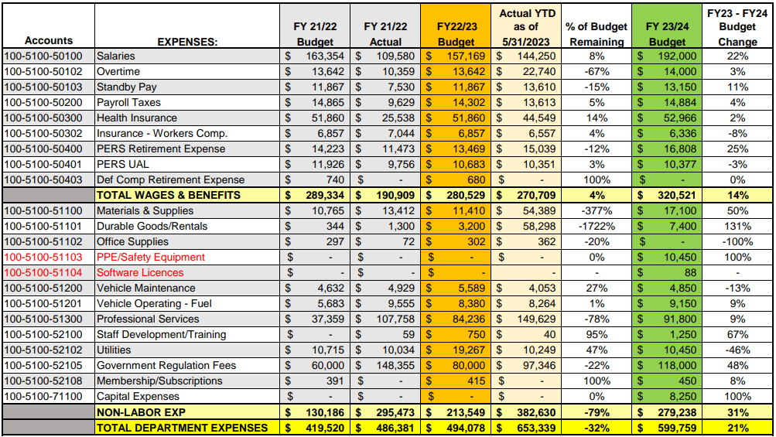
SOURCE OF SUPPLY - 5100

Slide 3
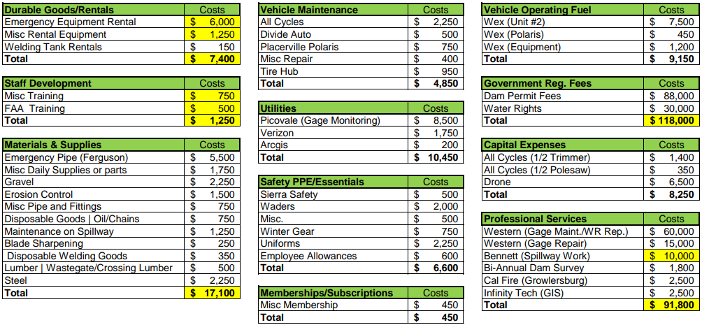
SOURCE OF SUPPLY - 5100

Slide 4
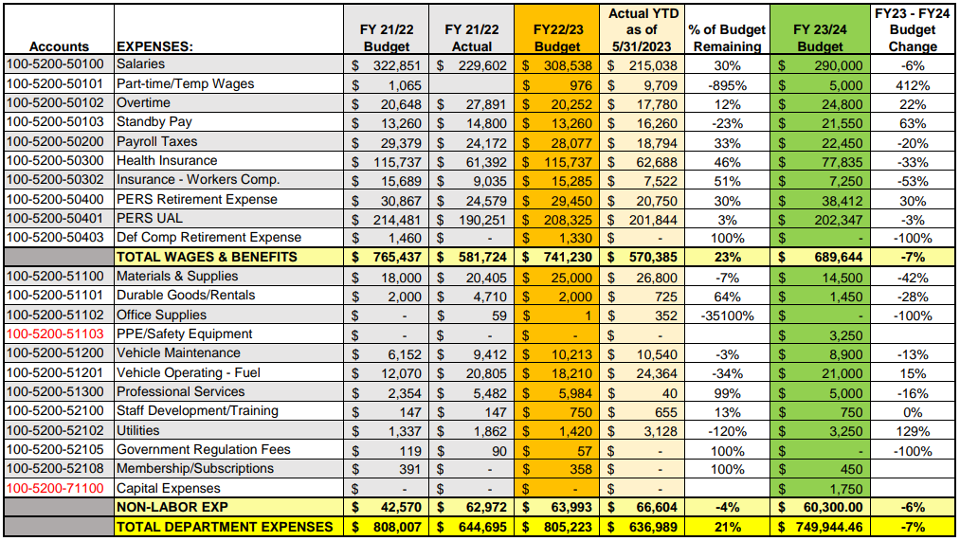
RAW WATER - 5200

Slide 5
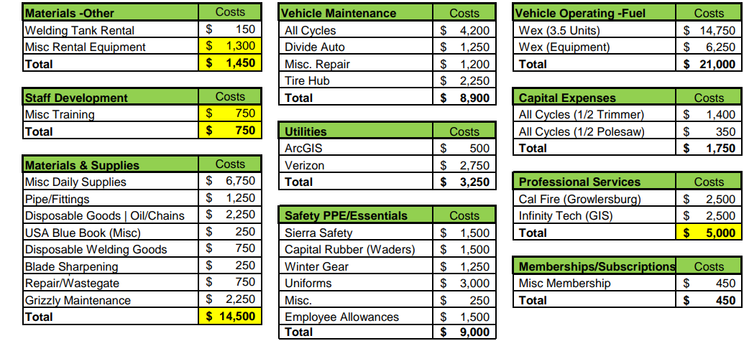
RAW WATER - 5200

Slide 6
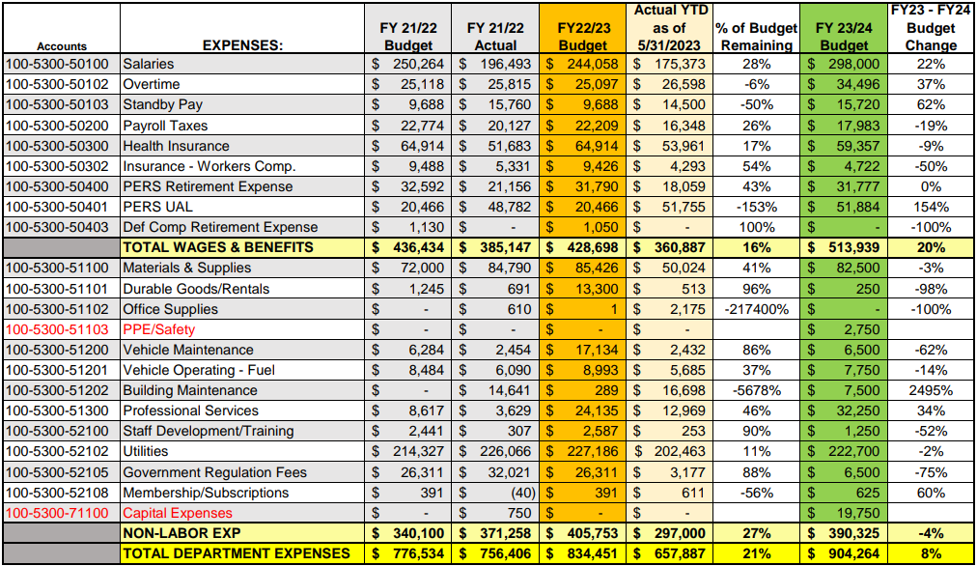
WATER TREATMENT - 5300

Slide 7
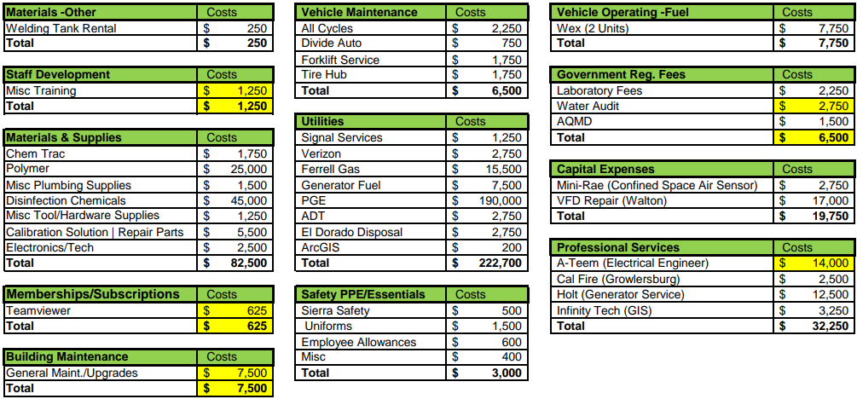
WATER TREATEMENT - 5300

Slide 8
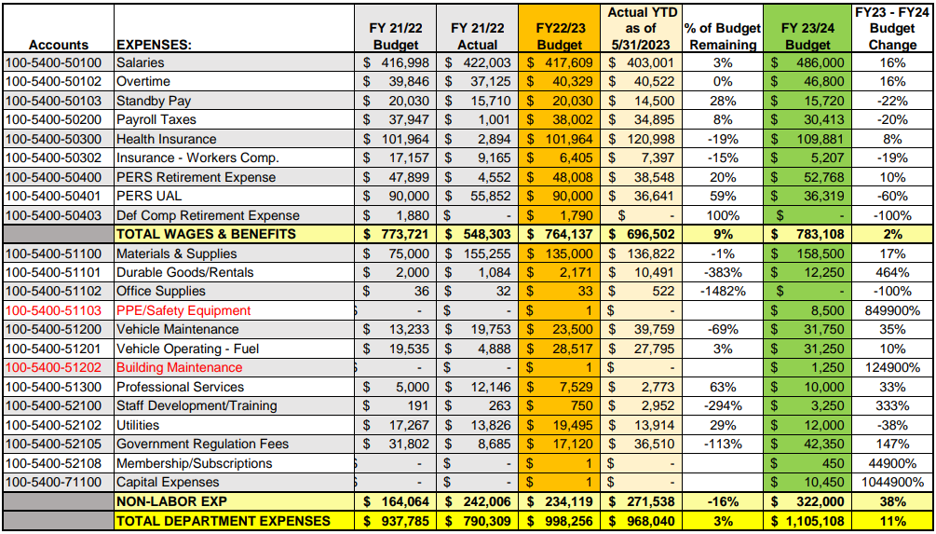
TREATED WATER - 5400

Slide 9
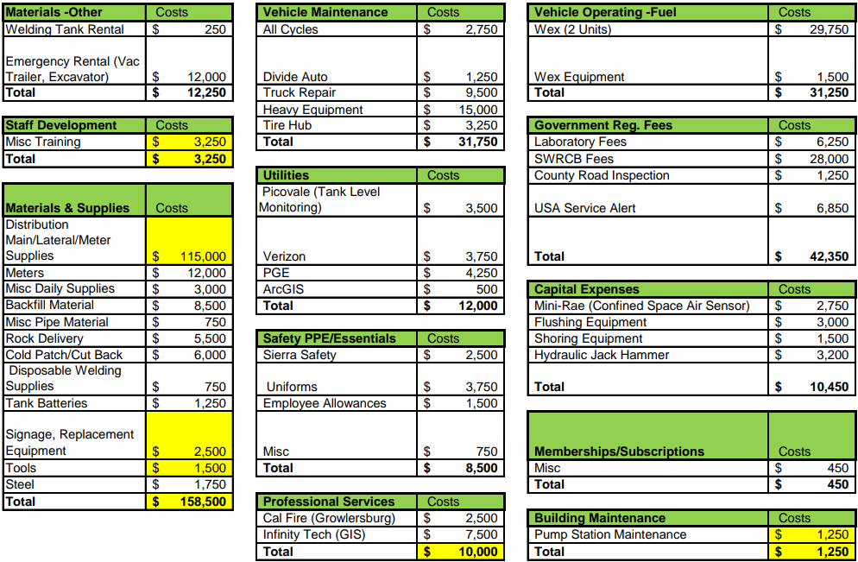
TREATED WATER - 5400

Slide 10
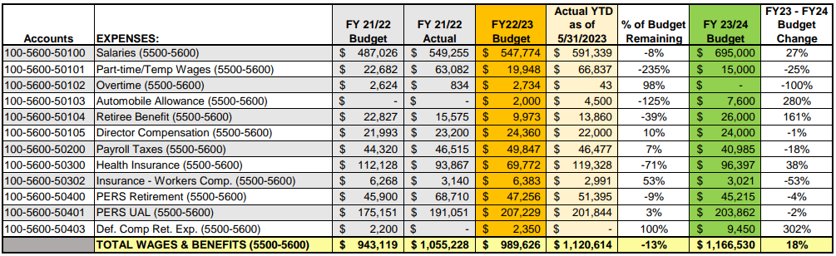
ADMINISTRATION - 5600

Slide 11
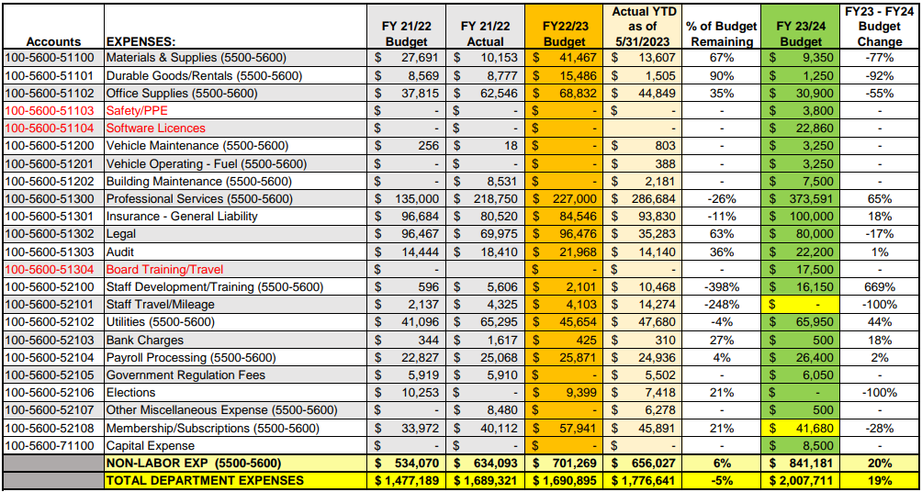
ADMINISTRATION – 5600 CONT.

Slide 12
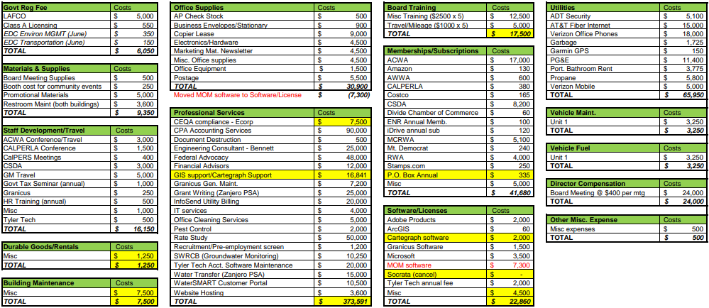
ADMINISTRATION - 5600

Slide 13
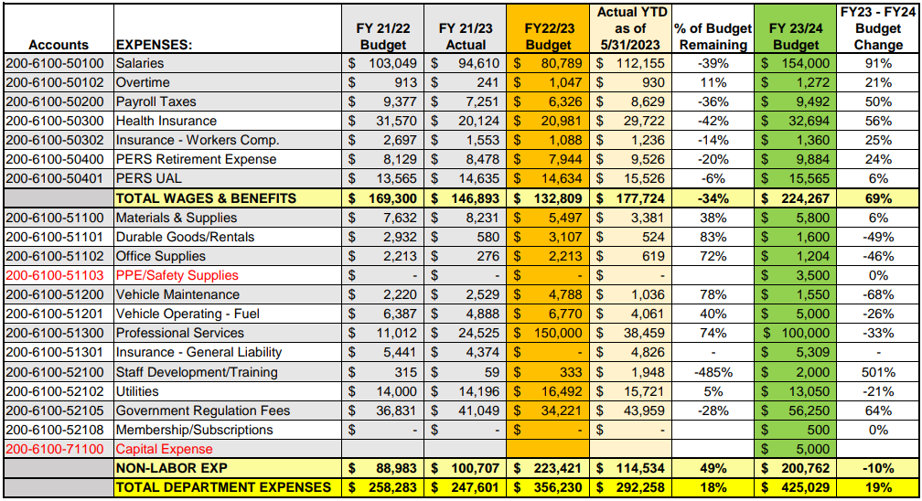
ZONE - 6100

Slide 14
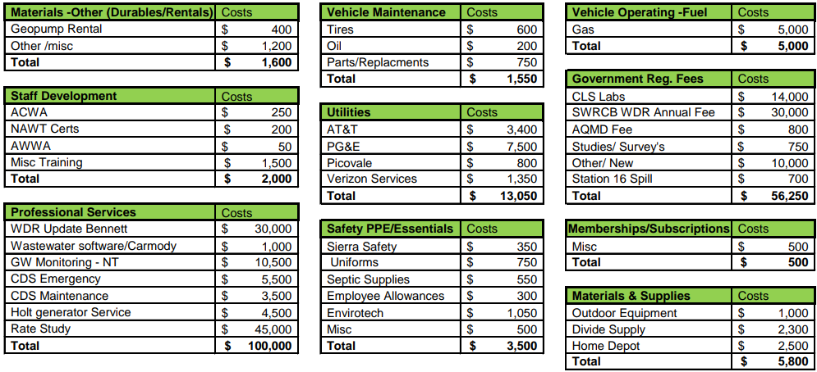
ZONE - 6100

Slide 15
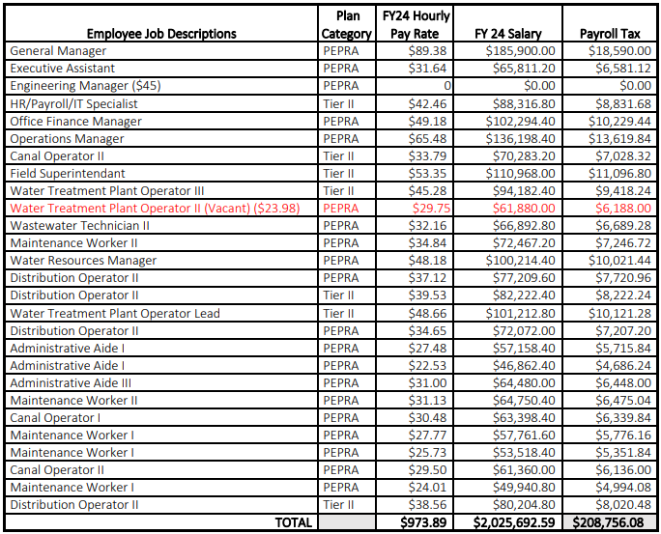
SALARIES – FISCAL YEAR 23-24

Slide 16
OVERTIME & STAND-BY PAY
Month |  |  | 5100 |  | 5200 |  | 5300 |  | 5400 |  | 6100
 | Weekdays | Weekend Days | Overtime | Standby | Overtime | Standby | Overtime | Standby | Overtime | Standby | Overtime | Standby
July | 20 | 11 | $ 2,200 | $ 1,350 | $ 4,400 | $ 2,150 | $ 3,388 | $ 1,350 | $ 1,300 | $ 1,350 |  | $ -
August | 22 | 9 | $ 1,800 | $ 1,330 | $ 3,600 | $ 2,210 | $ 2,772 | $ 1,330 | $ 1,300 | $ 1,330 |  | $ -
September | 20 | 10 | $ 2,000 | $ 1,300 | $ 4,000 | $ 2,100 | $ 3,080 | $ 1,300 | $ 1,300 | $ 1,300 |  | $ -
October | 22 | 9 | $ 1,800 | $ 1,330 | $ 3,600 | $ 2,210 | $ 2,772 | $ 1,330 | $ 1,300 | $ 1,330 |  | $ -
November | 21 | 9 |  |  |  |  | $ 2,772 | $ 1,290 | $ 1,300 | $ 1,290 |  | $ -
December | 20 | 11 | $ 600 | $ 1,350 | $ 400 | $ 2,150 | $ 3,388 | $ 1,350 | $ 1,300 | $ 1,350 | $ 318 | $ -
January | 22 | 9 | $ 600 | $ 1,330 | $ 400 | $ 2,210 | $ 2,772 | $ 1,330 | $ 1,300 | $ 1,330 | $ 318 | $ -
February | 21 | 7 | $ 600 | $ 1,190 | $ 400 | $ 2,030 | $ 2,156 | $ 1,190 | $ 1,300 | $ 1,190 | $ 318 | $ -
March | 21 | 10 | $ 600 | $ 1,340 | $ 400 | $ 2,180 | $ 3,080 | $ 1,340 | $ 1,300 | $ 1,340 | $ 318 | $ -
April | 22 | 8 |  |  |  |  | $ 2,464 | $ 1,280 | $ 1,300 | $ 1,280 |  | $ -
May | 22 | 9 | $ 1,800 | $ 1,330 | $ 3,600 | $ 2,210 | $ 2,772 | $ 1,330 | $ 1,300 | $ 1,330 |  | $ -
June | 20 | 10 | $ 2,000 | $ 1,300 | $ 4,000 | $ 2,100 | $ 3,080 | $ 1,300 | $ 1,300 | $ 1,300 |  | $ -
 |  | Totals | $ 14,000 | $13,150 | $24,800 | $21,550 | $34,496 | $15,720 | $46,800 | $15,720 | $ 1,272 | $ -
Weekday Rate | $ 40 |  | Assumptions:
Weekend/Holiday Rate | $ 50 |  | 5100/5200 - Weekend rounds ~4 hours during season (Off Season: 5100 - 3hrs pr/wk|5200 - 2hrs pre/wk)
 |  |  | 5300 - Weekend rounds ~4 hours
 |  |  | 5400 - 5 hours per week (Safety factor of 3)
Average 5100/5200 Hourly Rate | $ 50 |  | 6100 - 1.5 hour pr/wk rainy season
Average 5300 Hourly Rate | $ 88
Average 5400 Hourly Rate | $ 65
6100 Rate | $ 53

Slide 17
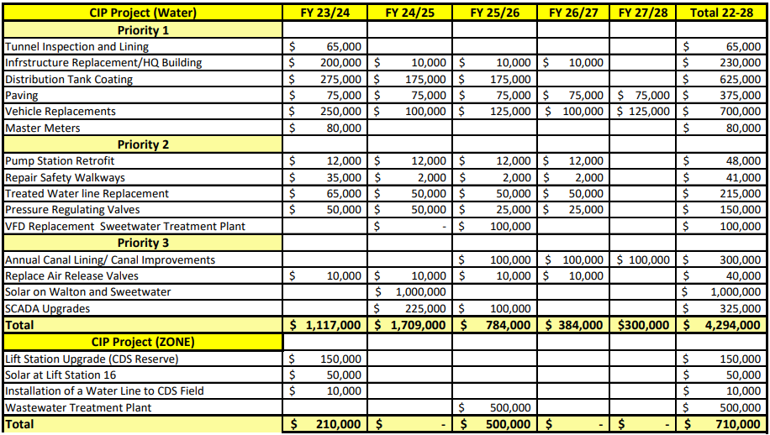
CAPITOL IMPROVEMENT PROJECTS – FUND 111

Slide 18
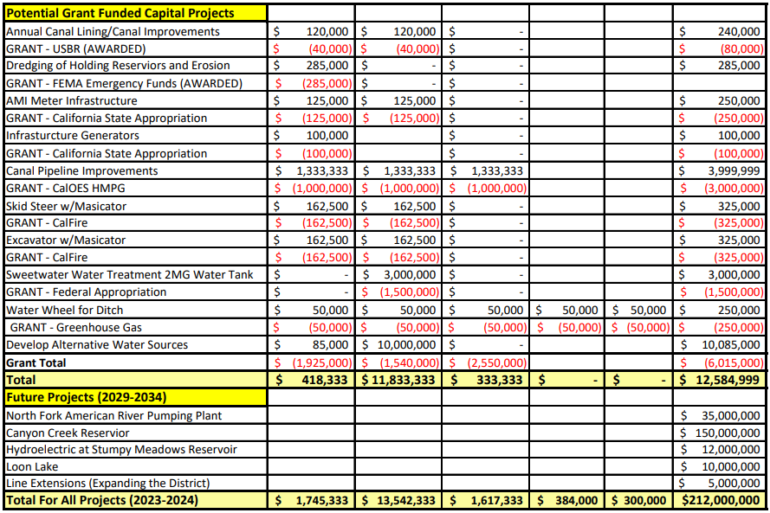
CAPITOL IMPROVEMENT PROJECTS CONT.

Slide 19
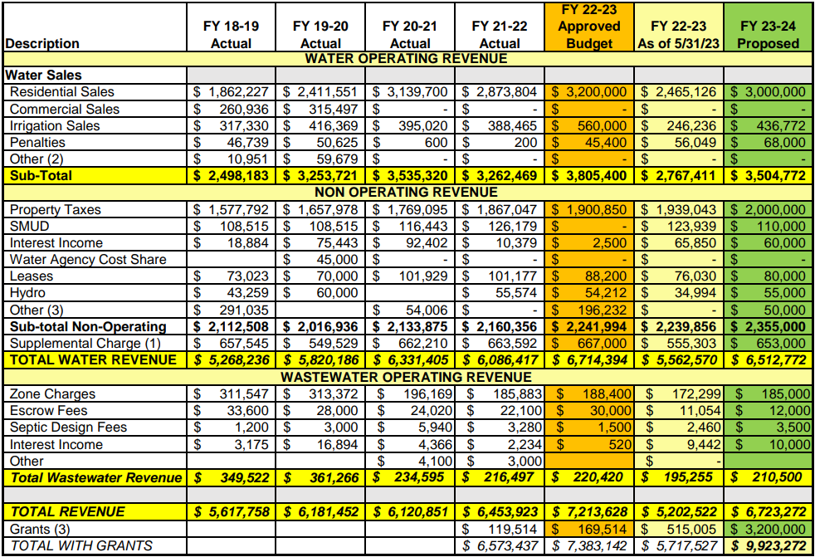
GDPUD REVENUE BUDGET

Slide 20
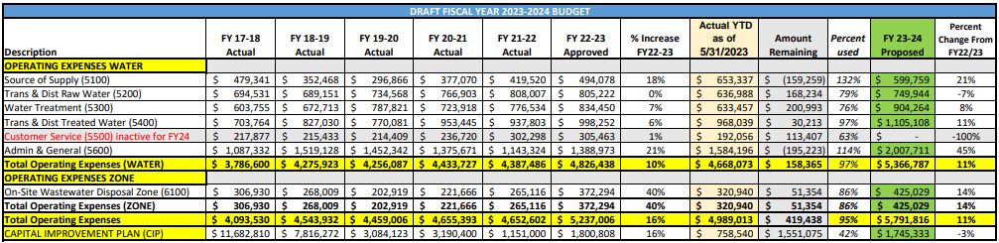
GDPUD OPERATING EXPENSES

